Slide 1
Arrays and Vectors
CPSC -131: Data Structures
Shrinivas Patil

Slide 2
Arrays
Collection of identical data
Fixed size once initialized cannot be resized
Index based structure
Contiguous memory allocation
Variable-size data is awkward
Use cases take time complexity o(n^2)
Slow
Accessing any elements completed in constant time
Reallocation of memory is not done implicitly

Slide 3
Use case- Reading Data of unpredictable size
Need to read a collection of values
User input, file, API call, database, etc.
Don’t know the size ahead of time
Algorithm: create data structure D while there is one more element x: add x to D
Do this all the time
Array code is O(n²), slow
Preview: vector, linked list code is O(n), fast

Slide 4
Real life application
Shopping Cart in e-commerce website
Task managers
Social media feeds
Music playlist
Email inbox

Slide 5
Vectors
array data structure works, but adding elements is slow
Because array is fixed-size
Vector: partially-filled, self-resizing array
Size: #elements stored in the structure
Capacity: length of backing array; at all times,
size ≤ capacity
Self-resizing: when overflow would happen
Allocate a larger backing array
Copy elements from old array to new array
Free old array

Slide 6
Vectors
Same as dynamic arrays
Ability of resize on inserting and deleting an element
Storage handled by container
Stored in contiguous memory
In c++ it is class template <vector>
Std::vector class provides several functionalities

Slide 7
Vector operations
This are some common operations :
Default Constructor | Create empty vector
Size() | Return number of elements in vector
Get(i) | Return element at index i
Set(i, x) | Assign element at index i
PushBack(x) | Add x to the back of the vector (highest index)
PopBack() | Remove the last element (highest index)

Slide 8
Simple Operations
Default constructor (empty vector):
Need to initialize capacity data member, initially 1
Backing array initially has size 1
Fill constructor:
Initialize size, capacity, backing array as empty (above)
Call PushBack(default_value) n times
Size, Get, Set: simply use backing array
Next: PushBack
(PopBack omitted)

Slide 9
PushBack
PushBack(x): Add x to the back of the vector (highest index)
Algorithm:
If size=capacity, resize (now know size < capacity)
Array[i] = x
size++

Slide 10
Resizing Strategy
Initial capacity is 1
On a resize, double capacity (⨉2)
So 1, 2, 4, 8, 16, 32, 64, …
Intuition: while adding, resizes get more and more spaced out

Slide 11
Example: PushBack
Size = 0
Capacity = 1
Array
?

Slide 12
Example: PushBack
Size = 1
Capacity = 1 Added: 7
Array
7

Slide 13
Example: PushBack
Size = 2
Capacity = 4 Added: 7,3
Array
7
3
?
?

Slide 14
Example: PushBack
Size = 3
Capacity = 4 Added = 7,3,5
Array
7
3
5
?

Slide 15
Example: PushBack
Size = 4
Capacity = 4 Added: 7,3,5,8
Array
7
3
5
8

Slide 16
Example: PushBack
Size = 4
Capacity = 8 Added: 7,3,5,8
Array
7
3
5
8
?
?
?
?

Slide 17
Example: PushBack
Size = 5
Capacity = 8 Added: 7,3,5,8,9
Array
7
3
5
8
9
?
?
?

Slide 18
Time Complexity
Recall: worst-case time means the maximum time of an operation (slowest)
Usually a fair measure
But can be unfair on
Repeated operations
Almost all operations are fast
But rare operations are slow
Worst-case analysis would focus on the “rare operations are slow”

Slide 19
Example: Buying Bag of Tomatoes
Consider you are buying bag of 12 tomatoes for 8$. Then use 1 for cooking.
Starting from nothing it costs:
8$,0$,0$,0$,0$,0$,0$,0$,0$,0$,0$,0$,8$,0$,....
This operation has one 8$, eleven 0$, repeats,...
Worst case cost: 8$.
Unfair to say each of 8$.
Amortized price is unit price.
Amortized price = Total price/Total tomatoes
= 8/12 = 0.66$ each

Slide 20
Amortized Time Complexity
Technique used to find average time complexity of algo has expensive operations
The idea is divide entire cost to each operation so that each one of them will have constant or less cost
average big-O time of a sufficiently long sequence of operations
If O(c) operations take a total of O(t) time, then the amortized time of one operation is
O(t) / O(c)
Often, O(n) operations take a total of O(n) time, so the amortized time of one operation is
O(n) / O(n) = O(1) amortized time

Slide 21
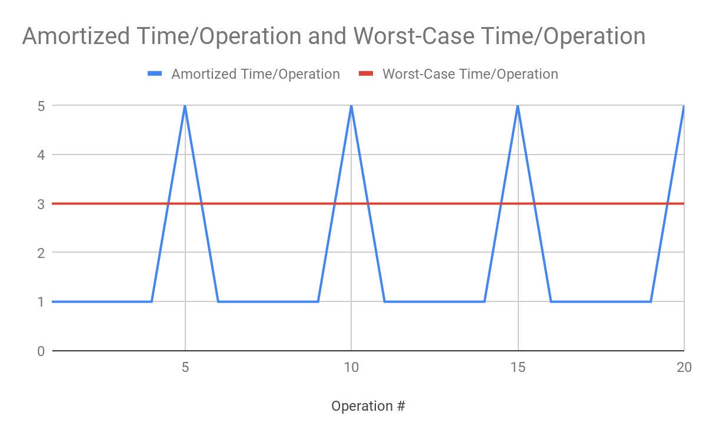

Slide 22
Goal
Recall analyze: examine operation code, determine big-O time
Goal: analyze the essential Vector operations
Default constructor
Size()
Get(i)
Set(i, x)
PushBack – add to back
(omitting PopBack)

Slide 23
Vector Data Members
size_t size_, capacity_; std::unique_ptr<T[]> elements_;
All operations are based on these

Slide 24
Default Constructor
Vector() : size_(0), capacity_(1), elements_(std::make_unique<T[]>(1)) {}
Sequence of steps – worst-case time is the bottleneck step
Initialize size_: O(1)
Initialize capacity_: O(1)
Initialize elements_: O(1)
Maximum of O(1), O(1), O(1) is O(1) (tie)
O(1) worst-case time

Slide 25
Get
T Get(size_t i) { if (i >= size_) { throw std::out_of_range(“i”); } return elements_[i]; }
Sequence of O(1) steps
O(1) worst-case time

Slide 26
Set(i,x)
void Set(size_t i, T x) { if (i >= size_) { throw std::out_of_range(“i”); } elements_[i] = x }
Again, O(1) worst-case time

Slide 27
PushBack(x)
void Resize() { capacity_ *= 2; std::unique_ptr<T[]> new_elements(std::make_unique<T[]>(capacity_)); for (size_t i = 0; i < size_; i++) { new_elements[i] = elements_[i]; } elements_.swap(new_elements); }
Loop: O(n)
Each other step: O(1)
O(n) worst-case time

Slide 28
Resize
void Resize() { capacity_ *= 2; std::unique_ptr<T[]> new_elements(std::make_unique<T[]>(capacity_)); for (size_t i = 0; i < size_; i++) { new_elements[i] = elements_[i]; } elements_.swap(new_elements); }
Loop: O(n)
Each other step: O(1)
O(n) worst-case time

Slide 29
Resize Amortized time
Claim: A sequence of O(n) PushBack operations spends O(n) total time in Resize.
Let n = size immediately after a Resize
At that moment, capacity = 2n
The next n PushBack operations do not overflow; O(1) time each
The (n+1)^{th} PushBack does overflow and resize; O(n) time
So (n+1) PushBacks; n ✕ O(1) + O(n) = O(n) total time
O(n) PushBacks take O(n) total time, so one PushBack takes O(1) amortized time
O(1) amortized time

Slide 30
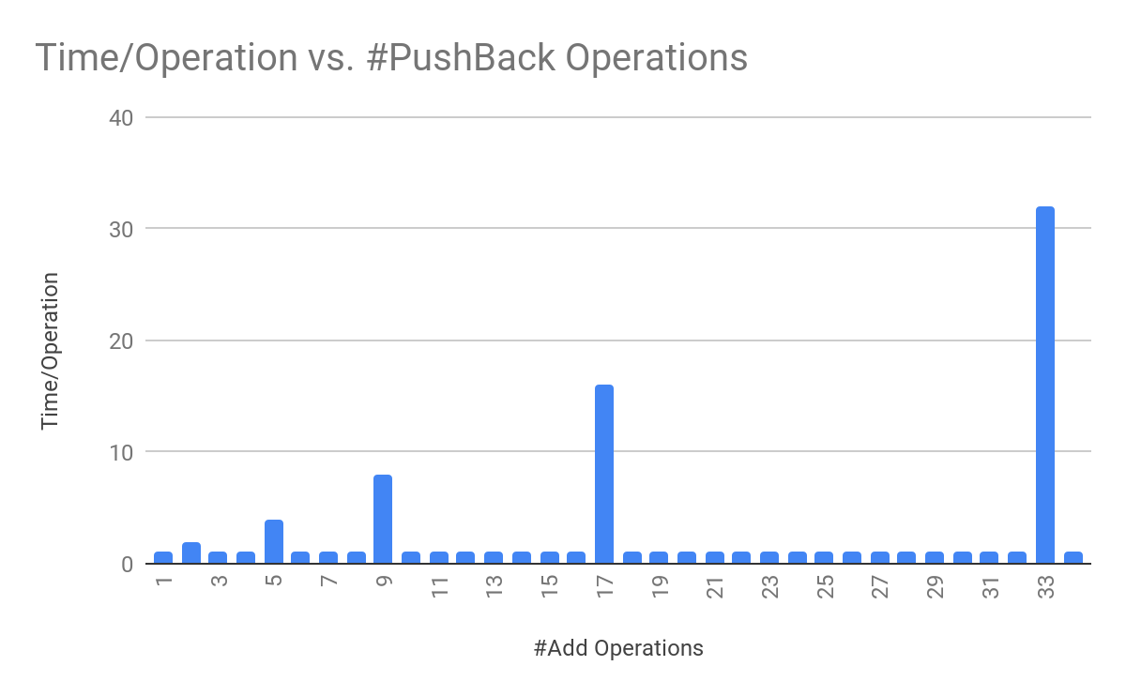

Slide 31
PushBack Summary
PushBack takes, aside from Resize: O(1)
Resize takes O(1) amortized time
Total time for PushBack: O(1) + O(1) amort. = O(1) amortized time

Slide 32
Vector Time complexity analysis
Operation | Time Complexity
Default Constructor | O(1)
Size() | O(1)
Get(i) | O(1)
Set(i,x) | O(1)
PushBack | O(1) Amortized
PopBack | O(1) Amortized

